Slide 1
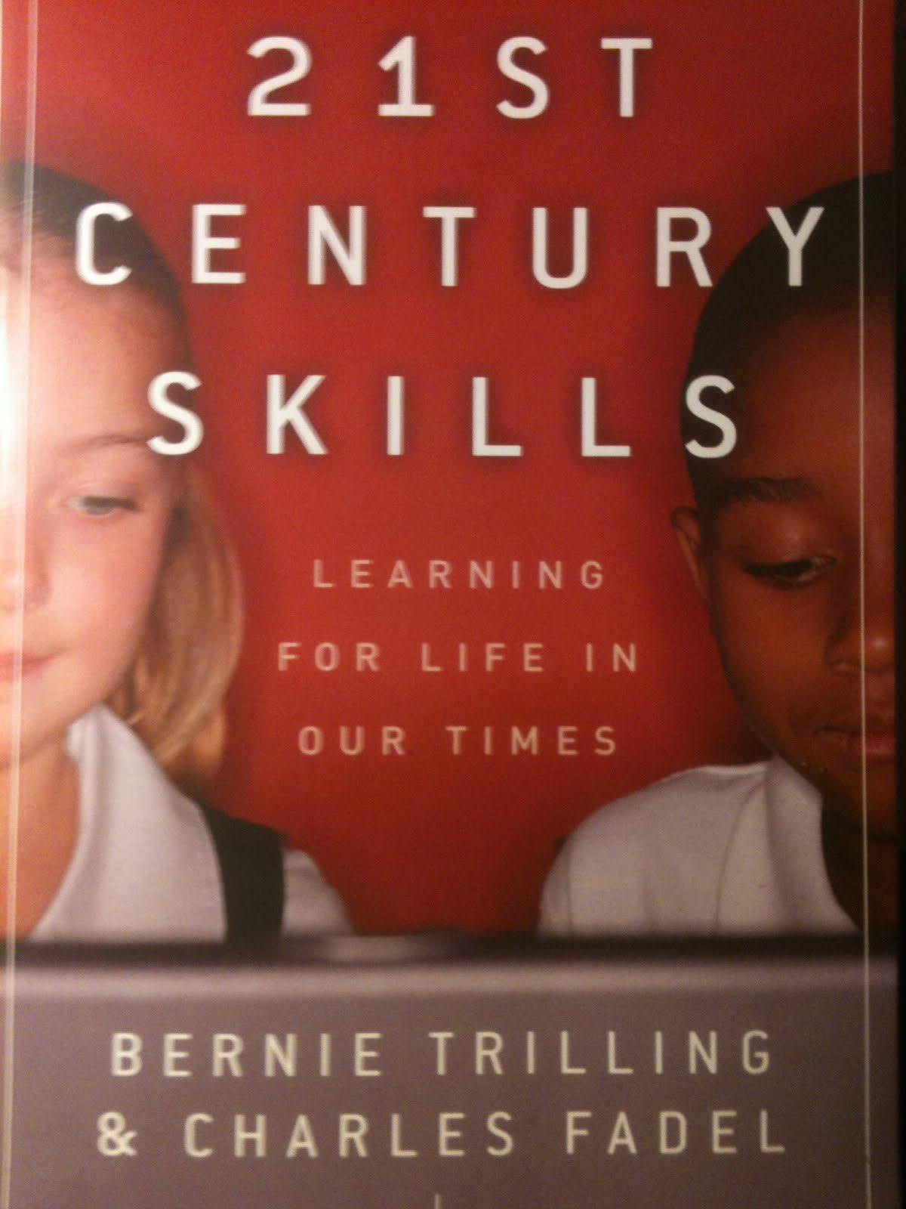
Book Presentation #3
by Carla Surber & John Lowell

Slide 2
Focus on 4 Critical Questions:
What will the world be like twenty or so years from now when your child has left school and is out in the world?
What skills will children need to be successful in the world you have imagined twenty years from now?
What were the conditions that made your high-performance learning experiences so powerful?
What would learning be like if it were designed around your answers to the first three questions?
Notes:
This book is a guide to 21st century skills, how they are working in schools around the world, and how they will be coming to more schools in the near future.

Slide 3
Organized into 3 sections:
What is 21st Century Learning?
What are 21st Century Skills?
21st Century Learning in Practice

Slide 4
What is 21st Century Learning?
Learning, Past & Future
Economies have shifted from the Industrial Age to the Knowledge Age, so too must education.
Skills needed according to the work world of today:
Oral & written communication
Critical thinking & problem solving
Professionalism & work ethic
Teamwork & collaboration
Working in diverse teams
Applying technology
Leadership & project management
Notes:
More creative work is necessary in the global job market than routine work requiring expertise. The history of education has revolved around an agrarian calendar and prepared the masses for the industrial work world. Education's role in the 21st century is to contribute to a global society, use personal talents for problem solving, and ensuring civic responsibilities.

Slide 5
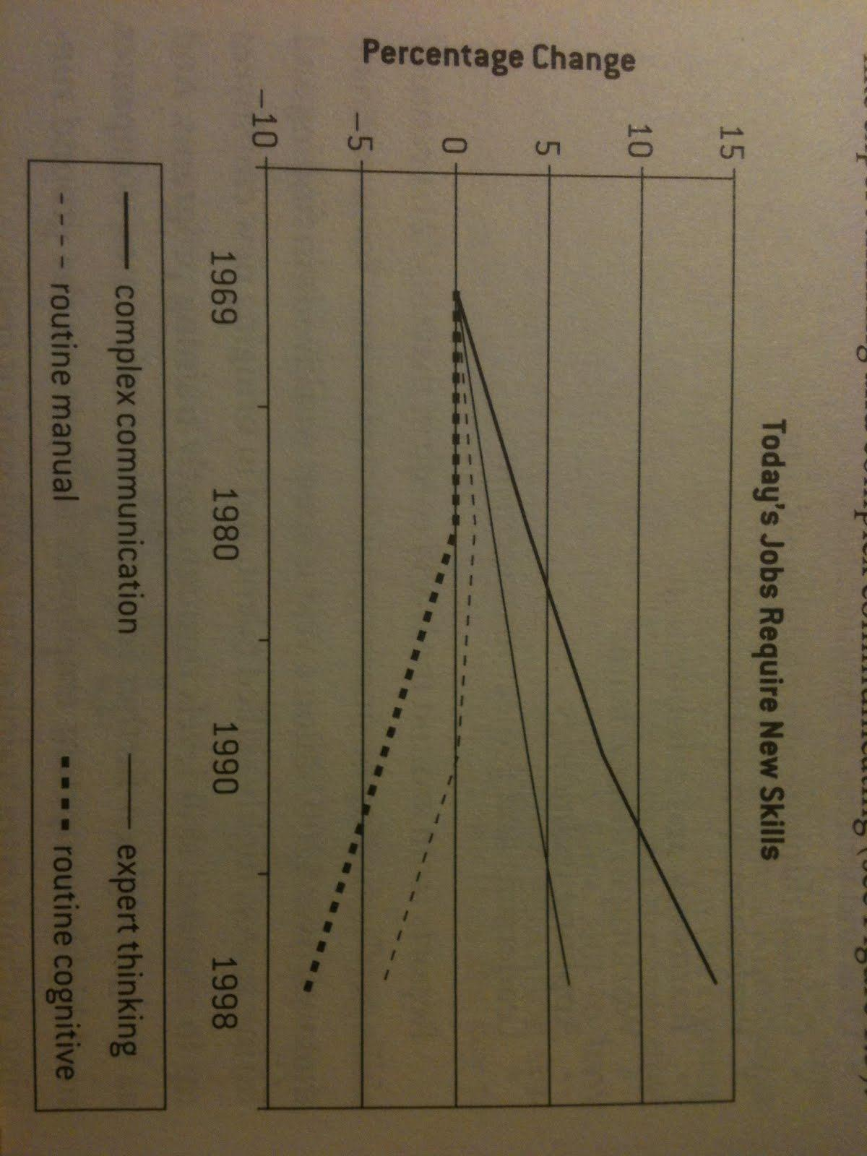
What is 21st Century Learning?

Slide 6
What is 21st Century Learning?
The Perfect Learning Storm
21st Century learning requires four converging forces:
Knowledge Work: knowledge that is skills based as opposed to rote memorization and focused on expertise.
Thinking Tools: A toolkit of digital devices that allow for the communication and synthesis of worldwide knowledge.
Digital Lifestyles: Blending digital systems used for personal use with the business and education spheres.
Learning Research: Authentic learning that uses multiple intelligences and is internally and socially motivating.
Notes:
With this paradigm shift there are still forces of resistance. Many policies, traditions, and fears block education reform for 21st century skills.

Slide 7
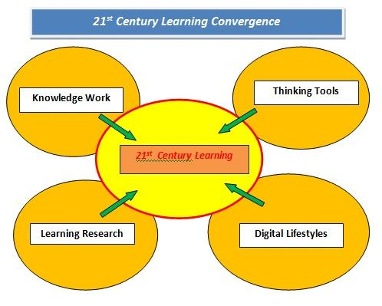
What is 21st Century Learning?
The Perfect Learning Storm

Slide 8
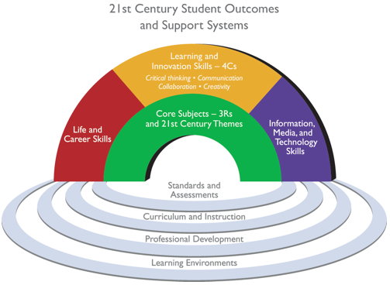
What are 21st Century Skills?
Learning & Innovation Skills
3 Cs (critical thinking, communication, creativity)
Inquiry & problem solving activities need to be taught from the beginning (pre-K to post-secondary)
Creativity is not just for the "gifted"
Creativity & innovation require an "environmental" overhaul: facilities, policies, & teachers
Communication & collaboration have to be taught and fostered through project opportunities & web-based tools
Notes:
Knowledge & Skills rainbow is a framework for desired student outcomes needed for the 21st century. What policies might need to change in order for all teachers to hold high expectations for all students and foster questioning, patience, openness to new ideas, trust, and the ability to learn from failures?

Slide 9
What are 21st Century Skills?
Digital Literacy Skills
21st Century skills require 3 types of literacy:
Information Literacy: Access, evaluate, and use information.
Media Literacy: Using, sorting, applying, and evaluating different forms of media.
Technology Literacy: Create standards and application accuracies for technology.
Notes:
Standards exist - TPACK, etc., but they are not yet widely used or even known about. It's hard to imagine some districts doing the work or inservice training. For example, Vallejo just cancelled their four remaining furlough days for 2nd semester -- the good news is the students will be in school more days (learning curriculum built around the CSTs), but the bad news is those days could have been used to inservice teachers on TPACK. Just saying. Those furlough days represent at least a million dollars.

Slide 10
What are 21st Century Skills?
Career & Life Skills
Students need to be taught
Flexibility & adaptability
Initiative & self-direction
Social and cross-cultural skills
Productivity & accountability
Leadership & responsibility
Notes:
While many of these skills have always been taught within the framework of public education, we will need to be strategic as the demands for all students to acquire these skills have increased dramatically for the 21st century.

Slide 11
21st Century Learning in Practice
Learning & Teaching
Question: What are the important tools we need to support a 21st century approach to learning & teaching?
The internet
Pen and paper
Cellphones
Educational Games
Tests and quizzes
A good teacher
Educational funding
Loving parents
All of the above
Notes:
Give a moment to think about it?

Slide 12
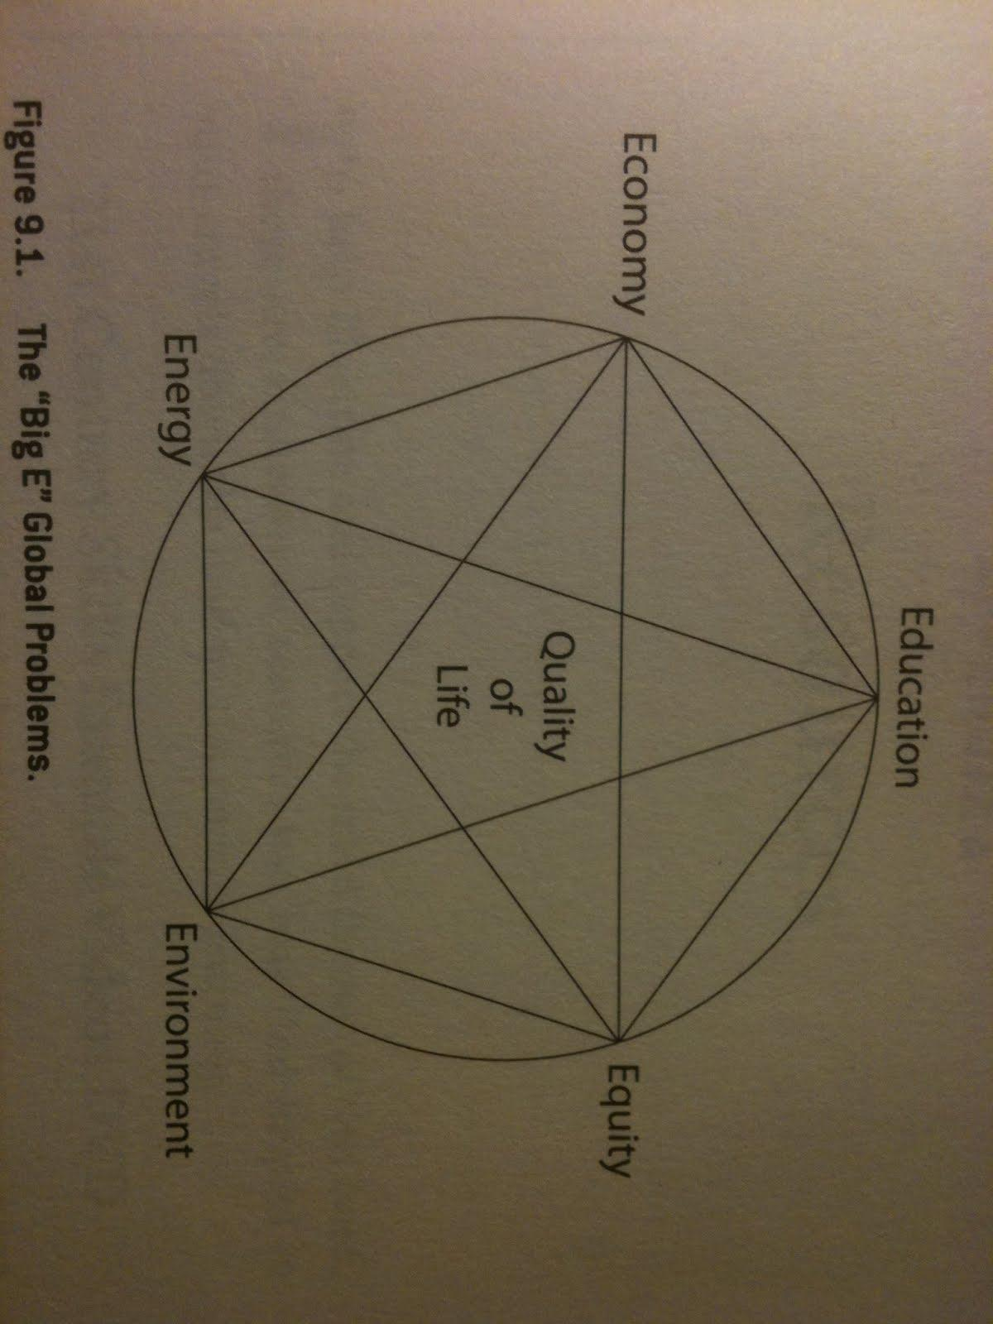
21st Century Learning in Practice
Learning & Teaching
Answer: All of the above. But two important things are missing.
Questions and the process to uncover their answers
Problems and the inventing of their possible solutions
Notes:
So what would a 21st century learning model look like that uses the power of problems & questions of engaged learning to drive deep interest, understanding, caring, and the application of 21st century skills to real-world challenges?

Slide 13
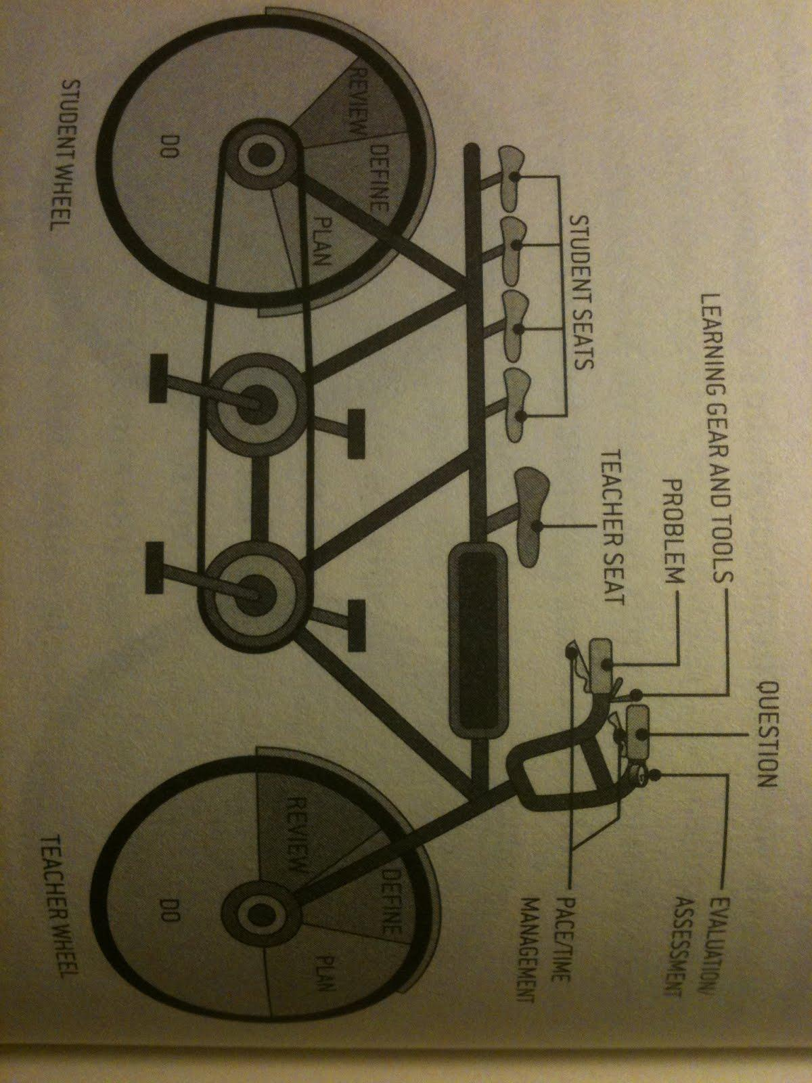
21st Century Learning in Practice
Powerful Learning
Notes:
Students & teachers must coordinate their project cycle work, co-managing the whole learning project (the bicycle frame), and using the driving question or problem (the handlebars) to steer and guide the project forward.

Slide 14
21st Century Learning in Practice
Retooling Schools
Notes:
Focus is on the front of the diagram. And in successful systems emerging around the world, we see six emerging principles that these initiatives seem to share: vision; coordination; official policy; leadership; learning technology; and teacher learning.

Slide 15
Learning for life...building a better world
"Given the challenges of our times, our students will need plenty of practice in using their 21st century skills to be better problem solvers and innovators, and the world could certainly use some passionate and creative problem solvers right now! It's time to give all our students the chance to learn how to build a better world."
Notes:
We must succeed in transforming our educational systems in order to prepare our students for meaningful and productive lives in the 21st century.

